Slide 1
CODE BLUE CART: HOMELESS RESCUE INITIATIVE
Stephen Anderson, Angela Herb, Matthew Horger, Andrew Johnson and Conor Waldt

Slide 2
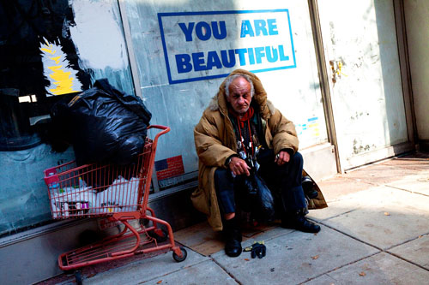
ADDRESSING COMMUNITY NEEDS
Reducing risk for homeless in cold weather
Saving the lives of the homeless
Providing effective means for enacting code blue program

Slide 3
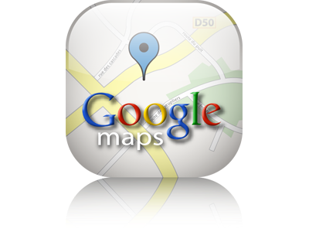
GPS
More efficient transportation to safety
Device sends coordinates to server
Server stores the coordinates in the database
Content management system takes coordinates from database and inputs them into google maps.
Easy visual guide for location of homeless persons
Police communications

Slide 4
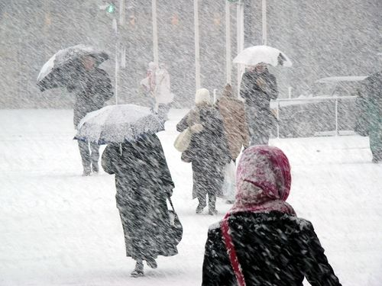
WEATHER CONDITION MONITORING
Prototype equipped with temperature sensor
Barometer and thermometer
Detects outside temperature and sends coordinates if below 32°F
Helps conserve power
Automatically detects Code Blue situations

Slide 5
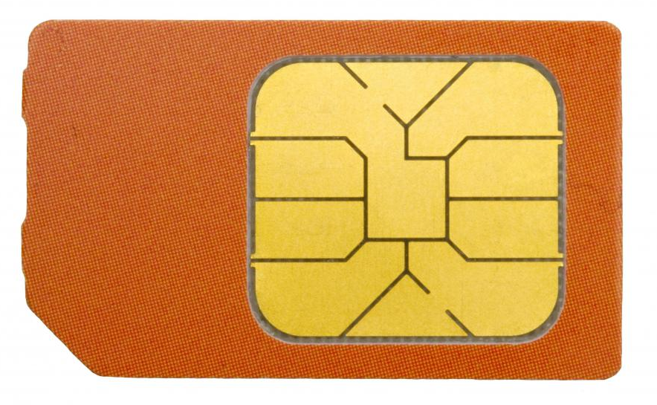
SIM CARD
Allows information to be transferred from arduino to the server
Functions whenever it can acquire a satellite fix

Slide 6

RECHARGING
the device currently has an 8 hour battery life.
It must be charged by a direct USB connection.

Slide 7
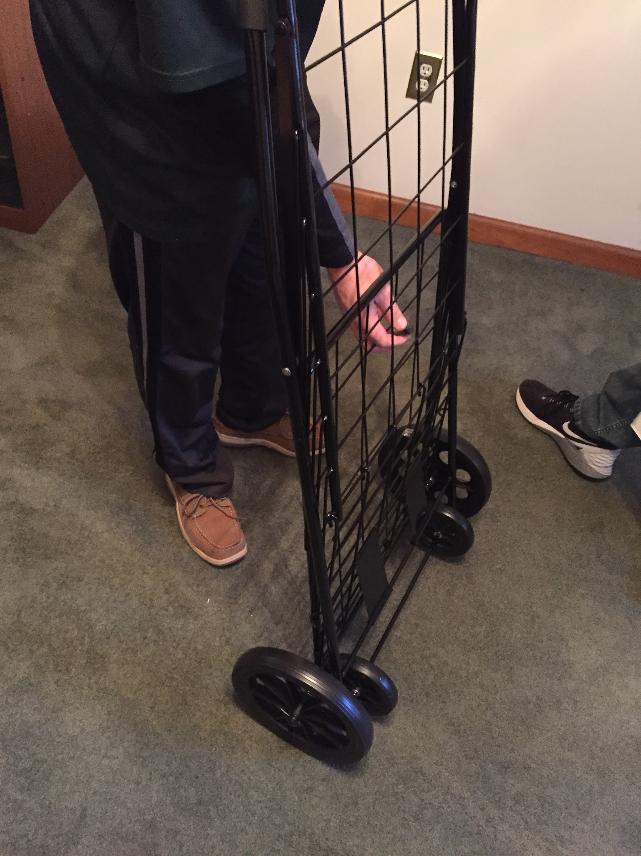
CART FEATURES
Foldable
Durable
Maneuverable
All Terrain
wheels - plastic with rubber tread

Slide 8
FUTURE IMPROVEMENTS
Creation of custom cart from scratch
Circuit board replacing components and wiring
Convert device to wearable fabric band
Sturdier prototype encasement
Advanced power saving techniques

